Slide 1

Study of Neural Network Based Approaches to implement Modern Chatbots

Slide 2

TABLE OF CONTENTS
Introduction
Literature Survey
Proposed Work
Conclusion
References

Slide 3
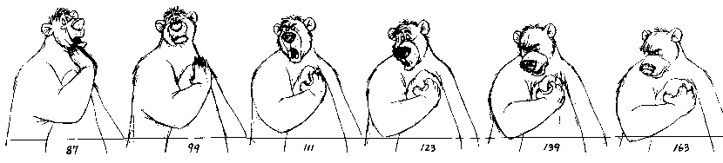
INTRODUCTION
Recurrent Neural Networks can accept sequences as an input.
The promise of adding more cells together will allow the model to explicitly learn and exploit context in sequence prediction models
State-of-the-art algorithm for sequential data
Used by Apple Siri and Google Voice Search

Slide 4

LITERATURE SURVEY

Slide 5
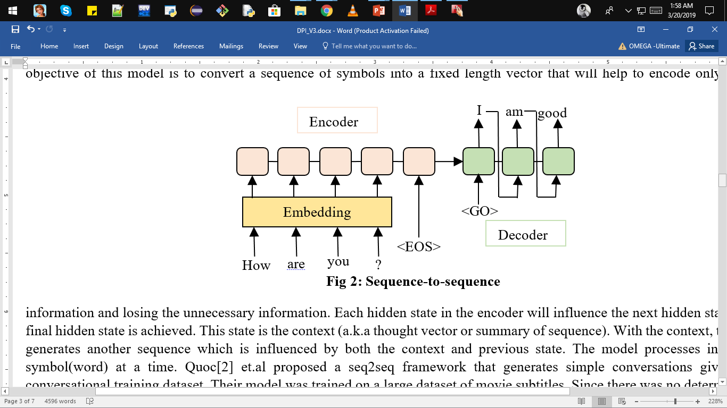
Paper Name: | A neural conversational model
Authors: | Vinyals, Oriol, and Quoc Le
Published In: | arXiv | Year: | 2015
Dataset: IT helpdesk troubleshooting dataset & Movie transcript dataset
2 RNNs – (1) Encoder, (2) Decoder
Final state of Encoder(i.e. <EOS>) is fed to Decoder first

Slide 6
Decoder consumes a correct sequence with the last token(<EOS>) removed.
Goal of training is to maximize the probability of Correct_Next_Word on each timestep.
Used SpeakerIDs for each utterance to judge an answer by not just depending on encoder state or speaker embedding.
Problems:
Generic Responses
Inconsistent Responses
For selective models instead of meeting the probability of a certain reply given certain context, they learn a similarity function where a reply is one of the elements in a pre-defined pool of possible answers. It will return the confidence of how appropriate the word is.

Slide 7
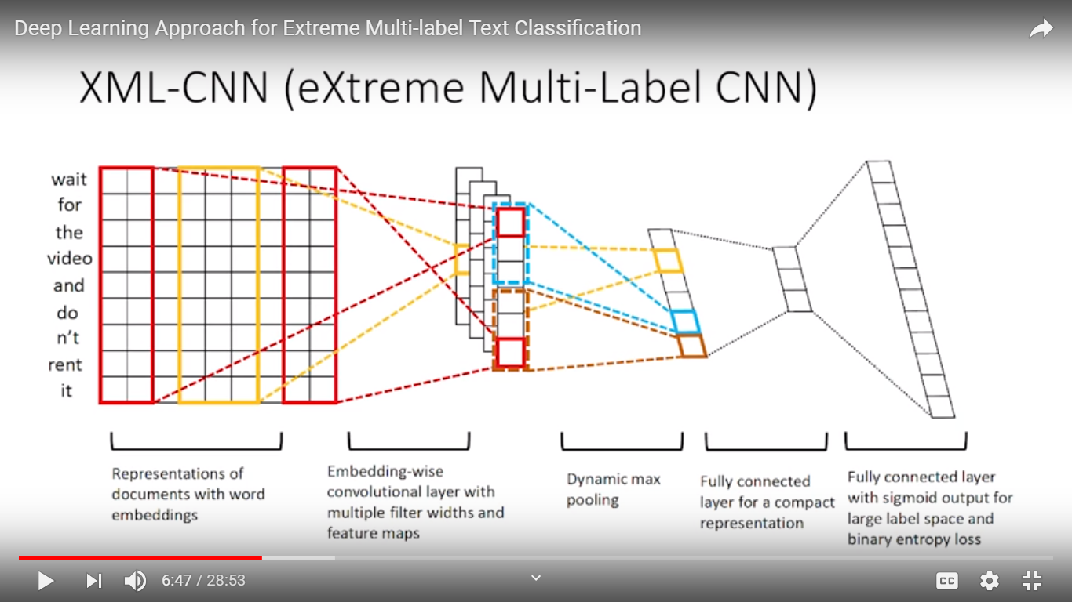
Paper Name: | Deep Learning for Extreme Multi-label Text Classification
Authors: | Jingzhou Liu, Wei-Cheng Chang, Yuexin Wu and Yiming Yang
Published In: | 40th International ACM SIGIR Conference on Research and Development in Information Retrieval | Year: | 2017
Representation of document with word embeddings
Embedding-wise convolution layer
Dynamic Max pooling
Fully Connected Layer

Slide 8
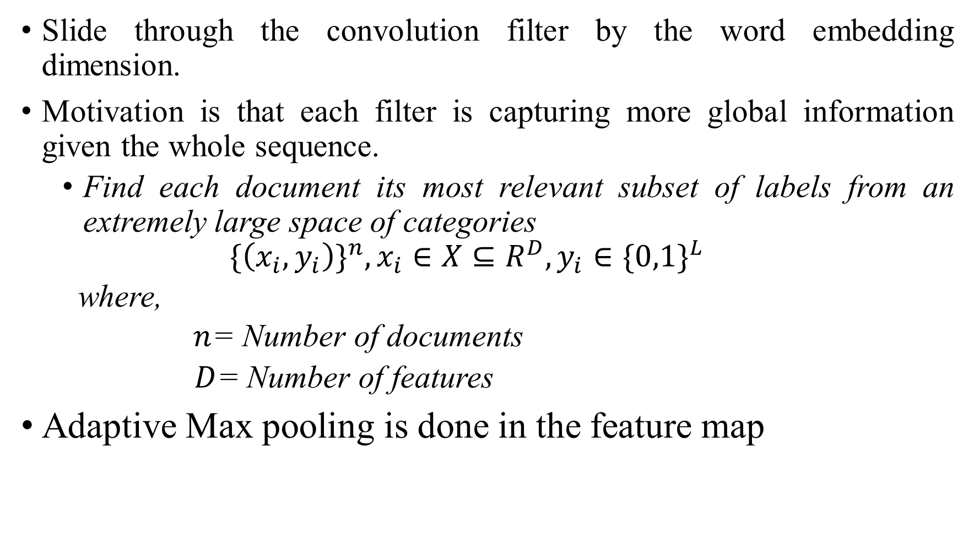
Slide through the convolution filter by the word embedding dimension.
Motivation is that each filter is capturing more global information given the whole sequence.
Find each document its most relevant subset of labels from an extremely large space of categories
$$\{\left(x_{i},y_{i}\right)\}^{n},x_{i}∈X⊆R^{D},y_{i}∈\{0,1\}^{L}$$
where,
$n$= Number of documents
$D$= Number of features
Adaptive Max pooling is done in the feature map

Slide 9
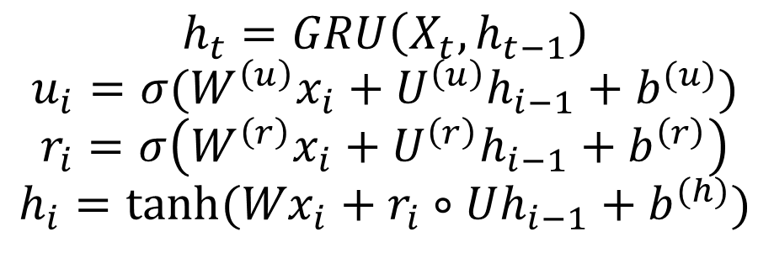
Paper Name: | Dynamic memory networks for natural language processing
Authors: | Ankit Kumar, Ozan Irsoy, Peter Ondruska, Mohit Iyyer, James Bradbury, Ishaan Gulrajani, Victor Zhong, Romain Paulus and Richard Socher
Published In: | arXiv | Year: | 2015
$$h_{t}=GRU\left(X_{t},h_{t−1}\right)$$
$$u_{i}=σ(W^{\left(u\right)}x_{i}+U^{\left(u\right)}h_{i−1}+b^{(u)})$$
$$r_{i}=σ\left(W^{\left(r\right)}x_{i}+U^{\left(r\right)}h_{i−1}+b^{\left(r\right)}\right)$$
$$h_{i}=tanh⁡({Wx}_{i}+r_{i}∘Uh_{i−1}+b^{(h)})$$
1st Module: INPUT MODULE
A GRU cell i.e. fed a sequence of word vectors
Outputs hidden states after every sentence, called facts
Reset gate learns to ignore the past timesteps when necessary
Update gate learns to ignore the current timestep entirely

Slide 10
2nd Module: QUESTION MODULE
Process the question word by word & outputs a vector using GRU
Creates episodic memory for both fact and question
Motivation from hippocampus of the human brain
Composed of 2 nested GRUs
Attention function outputs score between 0 and 1 which allows the GRU to ignore irrelevant fact
Multiple episode help the model to learn what part of the sentence it should pay attention to after realizing in 1st pass.
Multiple passes allows the model to gather increasingly relevant information.

Slide 11
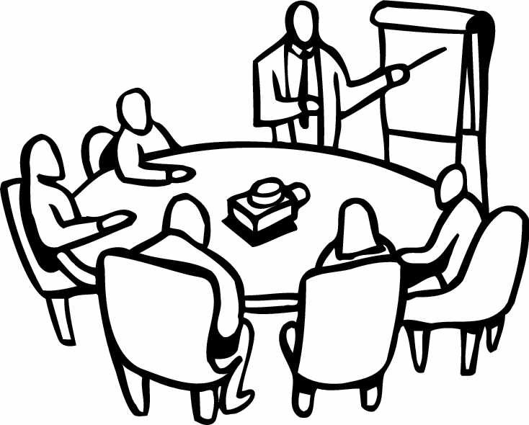
PROPOSED WORK

Slide 12
WHY RNNs FAILS?
Exploding / Vanishing Gradients
While propagating back from initial layer over several timesteps, values shrink exponentially until they vanish (i.e. Vanishing Gradient Problem)p
If the values grow bigger then they eventually blow up and crash the model (i.e. Exploding Gradient Problem)
Solution to Exploding Gradients
Gradient Clipping: Place a predefined threshold to prevent the gradients from getting too large
Solution to Vanishing Gradients
ReLU: Encourages the network compution close to the identity function
LSTM: Can easily capture long-term dependencies in sequence data

Slide 13
GloVe: Global Vectors
Unsupervised learning algorithm developed by Stanford
Provides a count-based approach
Constructs a large co-occurrence matrix of words by context
For each row (i.e. word), it will count how frequently it sees it in the same column (i.e. context)
Each row will have a feature representation for each word
It trains faster
Resulting embeddings show interesting linear substructures of the word in vector space.

Slide 14
REFERENCES
Vinyals, Oriol, and Quoc Le. "A neural conversational model." arXiv preprint arXiv:1506.05869 (2015).
Liu, Jingzhou, et al. "Deep learning for extreme multi-label text classification." Proceedings of the 40th International ACM SIGIR Conference on Research and Development in Information Retrieval. ACM, 2017.
Anything, Ask Me. "Dynamic memory networks for natural language processing." Kumar et al. arXiv Pre-Print (2015).
Bhagwat, Vyas Ajay. "Deep Learning for Chatbots." (2018).
https://nlp.stanford.edu/projects/glove/

Slide 15


